Slide 1
Recommendation System

Slide 2
Course Recommendation System (Udemy-like Platform)
👤 Presented by: [Mazen Khaled] 🧠 Supervised by: [Doctor Safaa] 🏫 Faculty of Computers and Information 📍 [Helwan University] 📅 Academic Year 2025 / 2026

Slide 3
Introduction / Problem Statement
Online learning platforms offer thousands of courses across various fields. However, students often struggle to find courses that match their interests, goals, or prior learning.
Goal: To build an intelligent recommendation system that helps users easily discover relevant courses based on search queries and enrolled course history.

Slide 4
Project Objectives & Scope
Main Objective: To design and implement a Course Recommendation System that suggests relevant courses based on content similarity and user interests.
Specific Objectives:
Implement Content-Based Filtering using:
TF-IDF Vectorization for text similarity.
SBERT (Sentence-BERT) for semantic understanding of course descriptions.
Build a FastAPI Web Application to serve real-time recommendations.
Scope:
Uses course title and description data.
Focused on personalized content similarity (no user interaction history yet).
Can be extended later with collaborative filtering or user feedback.

Slide 5
System Architecture
Overview: The system is built as a modular pipeline combining data processing, machine learning models, and a FastAPI interface.
Architecture Layers:
Data Layer
Source: CSV file containing course names and descriptions (~5,000+ rows).
Cleaning: Text normalization (lowercasing, removing punctuation, stopwords).
Feature Extraction Layer
TF-IDF Vectorizer: Captures word frequency importance.
Sentence-BERT: Converts descriptions into dense semantic embeddings.
Similarity & Recommendation Layer
Cosine Similarity used to measure similarity between course vectors.
API Layer (FastAPI)
/search → retrieves similar courses based on a text query.
/recommend → suggests courses based on enrolled courses.
Frontend / Integration Layer
Ready to be connected with a user interface or chatbot in future.
Can serve educational platforms or personalized dashboards.

Slide 6
Dataset & Preprocessing
Data Collection
The dataset was manually built from three Kaggle datasets to ensure diversity in course topics and styles.
Sources:
all_courses.csv — general e-learning courses
udemy_courses.csv — Udemy platform data (course names, descriptions, ratings)
online_courses.csv — online education metadata from multiple providers
Key columns used:
course_name — short human-readable title
description — course description / syllabus text
clean_text — preprocessed text used by models
Preprocessing Steps (applied to description → clean_text)
Normalize text: lower() all characters
Tokenization + stopword removal (English stopwords)
Lemmatization (spaCy) — reduces words to base form
Save cleaned DataFrame and order

Slide 7
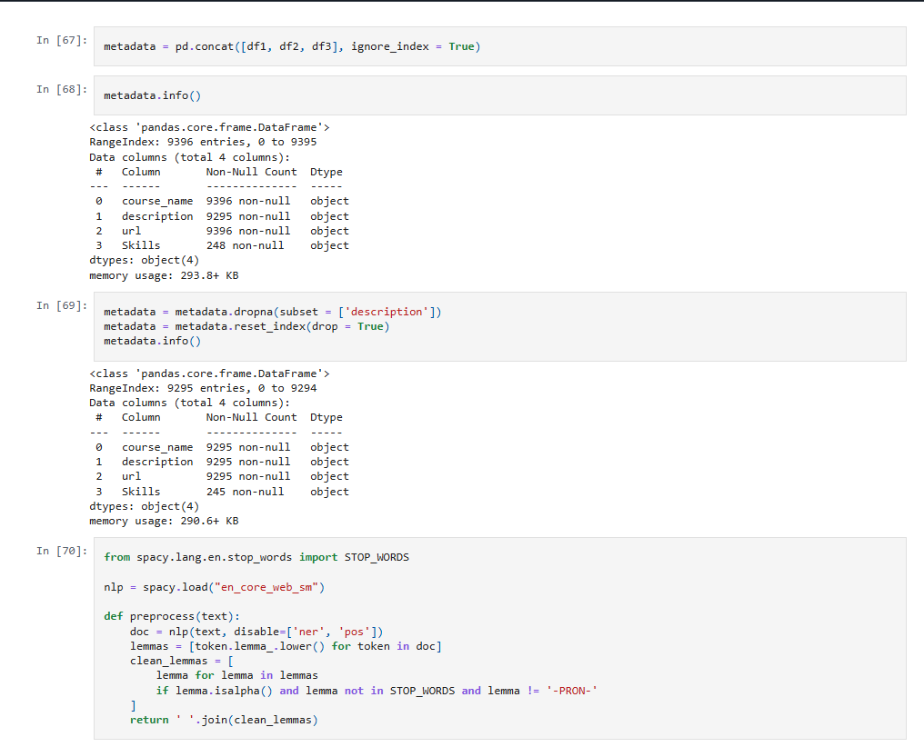
Dataset & Preprocessing

Slide 8
TFIDF MODEL
TF-IDF Model (Keyword-based Search)
Goal: Retrieve courses similar to a user query using textual similarity.
Model Used: TfidfVectorizer from scikit-learn.
Process:
Convert clean_text into numerical vectors using TF-IDF.
Store vectors in a sparse matrix (tfidf_matrix).
On query:
Transform query → vector
Compute cosine similarity between query and all courses
Return top-N matches

Slide 9
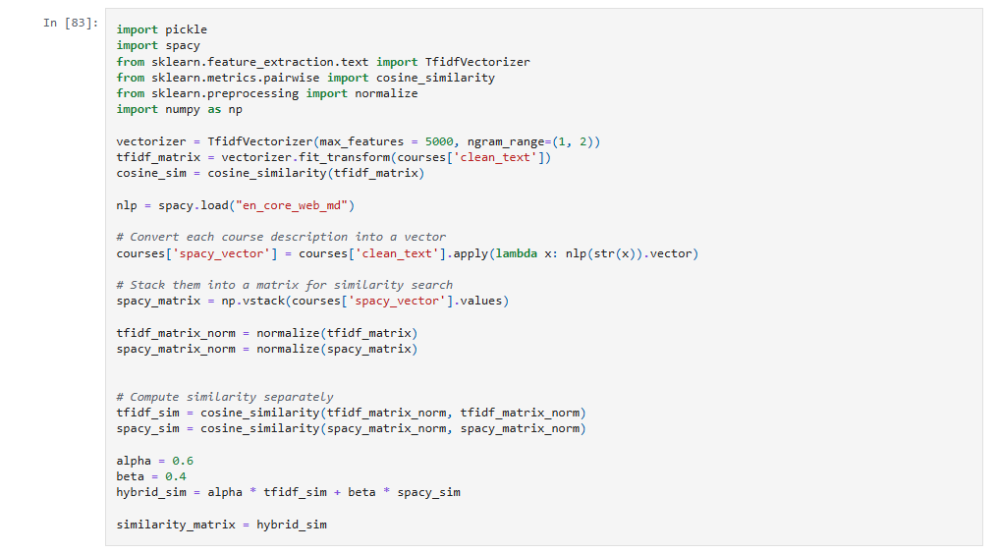
TFIDF MODEL

Slide 10
Sentence Transformer
SBERT (Sentence Transformer — Semantic Model)
Model: all-MiniLM-L6-v2 (from HuggingFace)
Purpose: Understand meaning, not just words.
Encoding: Each course description → 384-dimensional embedding vector.

Slide 11
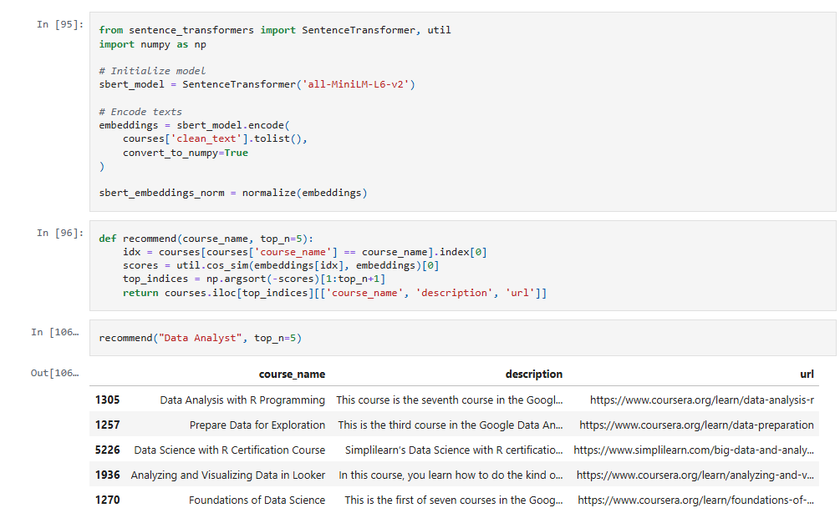
Sentence Trnsformer Model

Slide 12
API Implementation (FastAPI)
Core Components
TF-IDF Model → Keyword-based search engine
SBERT Model → Semantic understanding for user-based recommendations
Cosine Similarity → Measures similarity between vectors
FastAPI + Uvicorn → Lightweight, high-performance backend framework
Pickle + NumPy → Efficient model and vector loading

Slide 13
API Implementation (FastAPI)
Technical Components
Models Loaded:
tfidf_vectorizer.pkl
tfidf_matrix.pkl
sbert_embeddings.npy
courses_with_vectors.pkl
Libraries Used:
FastAPI, NumPy, pandas, scikit-learn, SentenceTransformer
Similarity Metric: Cosine similarity
System Flow:
User sends a query or enrolled course list via frontend.
Backend (API) receives the request.
The API fetches similarity scores using TF-IDF or SBERT embeddings.
Top 5 results are returned as a JSON response with name, description, and link.

Slide 14
Thank you
Brita Tamm
502-555-0152
brita@firstupconsultants.com
www.firstupconsultants.com

